Slide 1
ASP.NET
It is a web framework designed and developed by Microsoft. It is used to develop websites, web applications and web services
It provides fantastic integration of HTML, CSS and JavaScript

Slide 2
ASP.NET provides three development styles for creating web application
Web Forms
ASP.NET MVC
ASP.NET Web Pages

Slide 3
ASP.NET Page Lifecycle
Stage | Description
Page request | This stage occurs before the lifecycle begins. When a page is requested by the user, ASP.NET parses and compiles that page.
Start | In this stage, page properties such as Request and response are set. It also determines the Request type.
Initialization | In this stage, each control's UniqueID property is set. Master page is applied to the page.
Load | During this phase, if page request is postback, control properties are loaded with information.
Postback event handling | In this stage, event handler is called if page request is postback. After that, the Validate method of all validator controls is called.
Rendering | Before rendering, view state is saved for the page and all controls. During the rendering stage, the page calls the Render method for each control, providing a text writer that writes its output to the OutputStream object of the page's Response property.
Unload | At this stage the requested page has been fully rendered and is ready to terminate.at this stage all properties are unloaded and cleanup is performed

Slide 4
ASP.NET Web Forms
Web Forms are web pages built on the ASP.NET Technology.
We can use Visual Studio to create ASP.NET Web Forms.
To write business logic, we can choose any .NET language like: Visual Basic or Visual C#.
Web Forms are made up of two components: the visual portion (the ASPX file), and the code behind the form, which resides in a separate class file

Slide 5
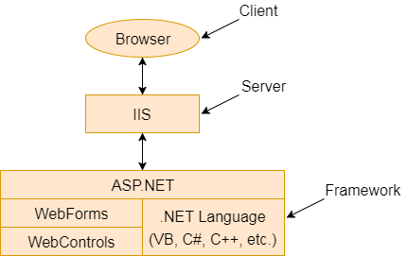
components of the ASP.NET

Slide 6
ASP.NET provides various controls
Server Controls
HTML Controls
server controls and HTML controls for the Web Forms

Slide 7
Server Controls
Control Name | Applicable Events | Description
Label | None | It is used to display text on the HTML page.
TextBox | TextChanged | It is used to create a text input in the form.
Button | Click, Command | It is used to create a button.
LinkButton | Click, Command | It is used to create a button that looks similar to the hyperlink.
ImageButton | Click | It is used to create an imagesButton. Here, an image works as a Button.
Hyperlink | None | It is used to create a hyperlink control that responds to a click event.

Slide 8
HTML Controls
Controls Name | Description
Button | It is used to create HTML button.
Reset Button | Resets all other HTML form elements on a form to a default value
Submit Button | Automatically POSTs the form data to the specified page listed in the Action attribute in the FORM tag
Text Field | Gives the user an input area on an HTML form
Text Area | Used for multi-line input on an HTML form

Slide 9
ASP.NET Web Forms Features
Server Controls
Master Pages
Working with data
Membership
Client Script and Client Frameworks
Routing
State Management
Security
Performance
Error Handling

Slide 10
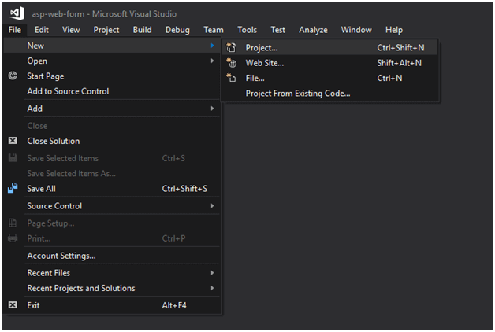
ASP.NET Web Forms Project
Creating a new project

Slide 11
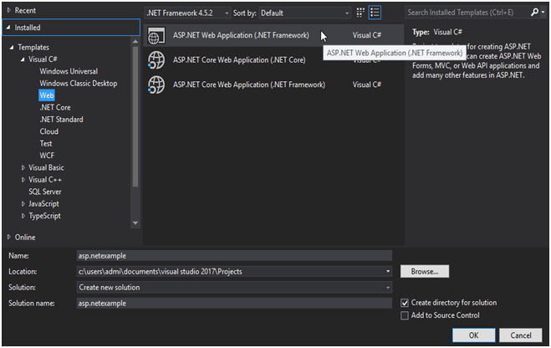
Select Project type

Slide 12
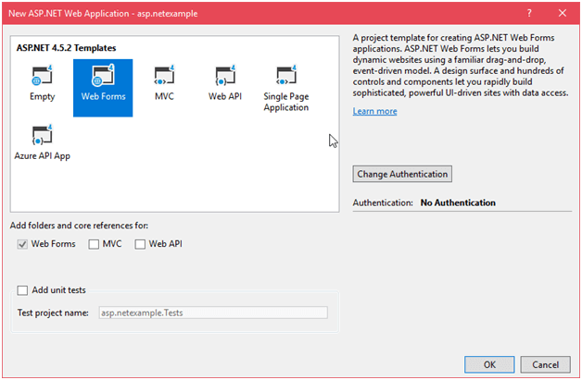
Select Project Template

Slide 13
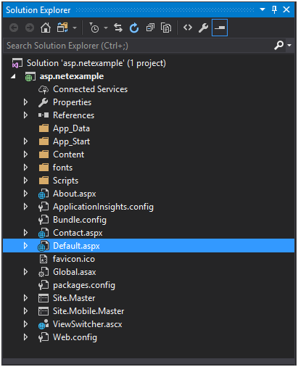
solution explorer

Slide 14
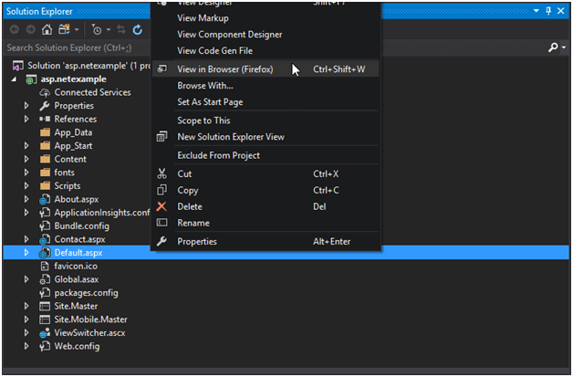
view in browser

Slide 15
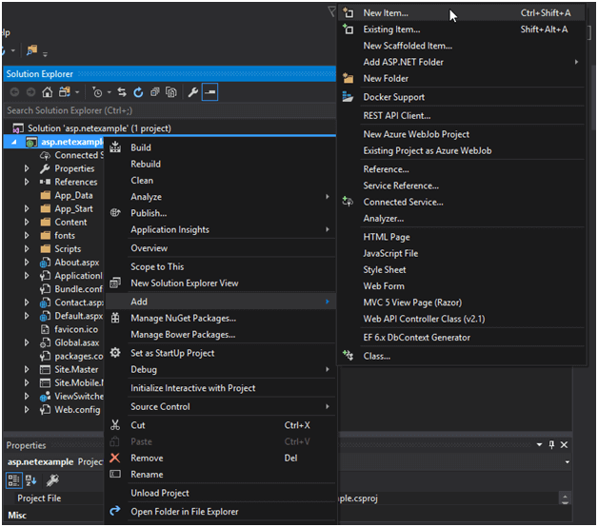
Create a New Web Form

Slide 16
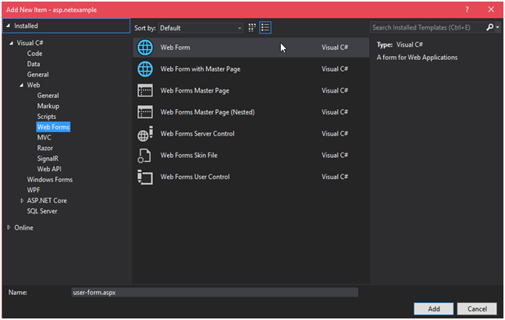

Slide 17
ASP.NET Web Forms Label
This control is used to display textual information on the web forms. It is mainly used to create caption for the other controls like: textbox.
< asp:LabelID="Label1" runat="server" Text="Label" ></asp:Label>

Slide 18
Property | Description
AccessKey | It is used to set keyboard shortcut for the label.
TabIndex | The tab order of the control.
BackColor | It is used to set background color of the label.
BorderColor | It is used to set border color of the label.
BorderWidth | It is used to set width of border of the label.
Font | It is used to set font for the label text.
ForeColor | It is used to set color of the label text.

Slide 19
ASP.NET Web Forms TextBox
This is an input control which is used to take user input. To create TextBox either we can write code or use the drag and drop facility of visual studio IDE.
< asp:TextBoxID="TextBox1" runat="server" ></asp:TextBox>

Slide 20
Property | Description
AccessKey | It is used to set keyboard shortcut for the control.
TabIndex | The tab order of the control.
BackColor | It is used to set background color of the control.
BorderColor | It is used to set border color of the control.
BorderWidth | It is used to set width of border of the control.
Font | It is used to set font for the control text.
ForeColor | It is used to set color of the control text.
Text | It is used to set text to be shown for the control.

Slide 21
ASP.NET Web Forms Button
This control is used to perform events. It is also used to submit client request to the server. To create Button either we can write code or use the drag and drop facility of visual studio IDE.
< asp:ButtonID="Button1" runat="server" Text="Submit" BorderStyle="Solid" ToolTip="Submit"/>

Slide 22
Property | Description
AccessKey | It is used to set keyboard shortcut for the control.
TabIndex | The tab order of the control.
BackColor | It is used to set background color of the control.
BorderColor | It is used to set border color of the control.
BorderWidth | It is used to set width of border of the control.
Font | It is used to set font for the control text.
ForeColor | It is used to set color of the control text.

Slide 23
ASP.NET Validation
To perform validation, ASP.NET provides controls that automatically check user input and require no code.
We can also create custom validation for our application.

Slide 24
ASP.NET validation controls
Validator | Description
CompareValidator | It is used to compare the value of an input control against a value of another input control.
RangeValidator | It evaluates the value of an input control to check the specified range.
RegularExpressionValidator | It evaluates the value of an input control to determine whether it matches a pattern defined by a regular expression.
RequiredFieldValidator | It is used to make a control required.
ValidationSummary | It displays a list of all validation errors on the Web page.

Slide 25
ASP.NET CompareValidator Control
This validator evaluates the value of an input control against another input control on the basis of specified operator.

Slide 26
ASP.NET RangeValidator Control
This validator evaluates the value of an input control to check that the value lies between specified ranges.
The ControlToValidateproperty is used to specify the control to validate. The MinimumValue and MaximumValue properties are used to set minimum and maximum boundaries for the control.

Slide 27
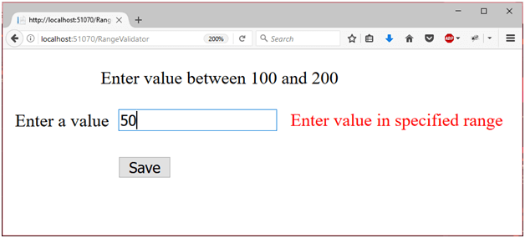

Slide 28
ASP.NET RegularExpressionValidator Control
This validator is used to validate the value of an input control against the pattern defined by a regular expression.
The ValidationExpression property is used to specify the regular expression, this expression is used to validate input control.

Slide 29
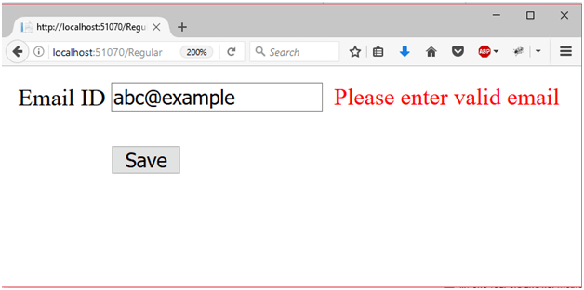

Slide 30
ASP.NET RequiredFieldValidator Control
This validator is used to make an input control required. It will throw an error if user leaves input control empty.

Slide 31
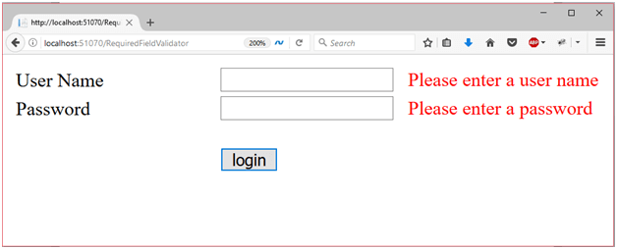

Slide 32
ASP.NET ValidationSummary Control
This validator is used to display list of all validation errors in the web form.
It allows us to summarize the error messages at a single location.
We can set DisplayMode property to display error messages as a list, bullet list or single paragraph.

Slide 33
